Slide 1


Implementing the Intelligent Systems Knowledge Units of Computing Curricula 2001
Ingrid Russell
Todd Neller

Slide 2
Outline
CC-2001 Intelligent Systems recommendations
Where core IS topics can fit in a constrained curriculum
Focus on Search and Constraint Satisfaction exercises for a Data Structures course
  Online resources we provide

Slide 3
CC-2001 Intelligent Systems Core Units (IS)
10 hours of Intelligent Systems recommended
Fundamental Issues (1 hour)
Knowledge Representation and Reasoning (4 hours)
Search and Constraint Satisfaction (5 hours)

Slide 4
CC-2001 Intelligent Systems Core Units (IS)
10 hours of Intelligent Systems recommended
Fundamental Issues (1 hour)
  Largely philosophical topics, definitions, issues
  → CC-2001 Social and Professional Issues core (16 hours)
Knowledge Representation and Reasoning (4 hours)
Search and Constraint Satisfaction (5 hours)

Slide 5
CC-2001 Intelligent Systems Core Units (IS)
10 hours of Intelligent Systems recommended
Fundamental Issues (1 hour)
  Largely philosophical topics, definitions, issues
  → CC-2001 Social and Professional Issues core (16 hours)
Knowledge Representation and Reasoning (4 hours)
  Propositional and predicate logic, resolution and theorem proving, nonmonotonic inference, probabilistic reasoning, Bayes’ theorem
Search and Constraint Satisfaction (5 hours)

Slide 6
CC-2001 Intelligent Systems Core Units (IS)
10 hours of Intelligent Systems recommended
Fundamental Issues (1 hour)
  Largely philosophical topics, definitions, issues
  → CC-2001 Social and Professional Issues core (16 hours)
Knowledge Representation and Reasoning (4 hours)
  No implementation recommended, coverage is conceptual and mathematical in nature
  → CC-2001 Discrete Structures core (43 hours)
Search and Constraint Satisfaction (5 hours)

Slide 7
CC-2001 Intelligent Systems Core Units (IS)
10 hours of Intelligent Systems recommended
Fundamental Issues (1 hour)
  → CC-2001 Social and Professional Issues core (16 hours)
Knowledge Representation and Reasoning (4 hours)
  → CC-2001 Discrete Structures core (43 hours)
Search and Constraint Satisfaction (5 hours)
  Integrate with a Data Structures and Algorithms course
  Different data structures yield different search behaviors
  Powerful illustrations of algorithm tradeoffs between time complexity, space complexity, and solution quality

Slide 8
Search and Constraint Satisfaction
Problem spaces
Brute-force search (breadth-first, depth-first, depth-first with iterative-deepening)
Best-first search (generic best-first, Dijkstra’s algorithm, A*, admissibility of A*)
Two-player games (minimax search, alpha-beta pruning)
Constraint satisfaction (backtracking and local search methods)

Slide 9
Search and Constraint Satisfaction
Problem spaces
Brute-force search (breadth-first, depth-first, depth-first with iterative-deepening)
Best-first search (generic best-first, Dijkstra’s algorithm, A*, admissibility of A*)
Two-player games (minimax search, alpha-beta pruning)
Constraint satisfaction (backtracking and local search methods)

Slide 10
“A Taste of AI”
Online resources for teaching
  Problem spaces
  Brute-force search
http://cs.gettysburg.edu/~tneller/resources/ai-search

Slide 11
A Taste of AI: Brute-Force Search Benefits
Strong motivating example for object-oriented design
Application of stacks and queues
Excellent example in recursive thinking
Good illustration of the relationship between stack-based and recursive algorithms
Outstanding opportunity to demonstrate design tradeoffs between time, space, and quality of result

Slide 12
A Taste of AI: Brute-Force Search Components
Problem Spaces:
  Object-oriented structure: SearchNode and Searcher
  Example SearchNode implementations
  Scalable SearchNode specifications
Brute-force search:
  Implementation, Experimentation, and Analysis
  Comparisons of Time Complexity, Space Complexity, and Quality (optimality and completeness) tradeoffs
  Additional topics (e.g. iteration-recursion relationship)

Slide 13
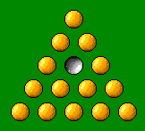
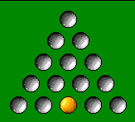
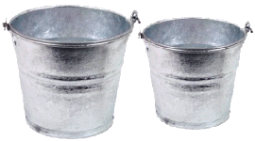
Problem Spaces
Search space (initial node + operators), costs, and goal test
Example problems:
  Triangular Peg Solitaire
  Bucket Problem
5
3

Slide 14
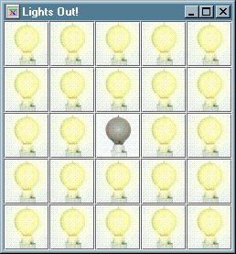
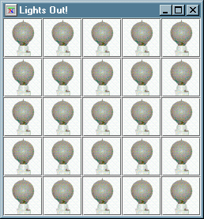
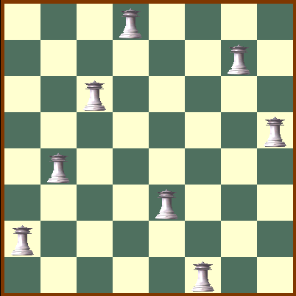
Problem Spaces (cont.)
Scalable problems specifications:
  Lights Out Puzzle
  Sliding Tile Puzzle
  Reverse Puzzle
  n-Queens Problem

Slide 15
Brute-Force Search
Russell & Norvig generalized algorithm:
Put root node in data structure
While the data structure is not empty:
  Get node from data structure
  If node is a goal, terminate w/ success
  Otherwise, put successors in data structure

Slide 16
Brute-Force Search (cont.)
Breadth-first search (queue)
Depth-first search (stack)
  Iterative and recursive implementations
Depth-limited search: depth-first search + depth limit
Iterative-deepening depth-first search: successive depth limited searches with limit 0, 1, …

Slide 17
Brute-Force Search (cont.)
Excellent study in tradeoffs!
  Time complexity
  Space complexity
  Quality
    Search completeness
    Solution optimality

Slide 18
Summary
CC-2001 Intelligent Systems core units
  Fundamental Issues unit with Social and Professional Issues units
  Knowledge Representation and Reasoning unit with Discrete Structures units
  Search and Constraint Satisfaction unit with Data Structures and Algorithms course

Slide 19
Online Resources
“Taste of AI: Brute-Force Search” assignment resources (Java, C++)
http://cs.gettysburg.edu/~tneller/resources/ai-search
5
3

Slide 20
Example Problems
Triangular Peg Solitaire
Initial state: 5-on-a-side triangular grid of holes filled with peg except one central hole
Operators: removal by linear jumps
Goal state: one peg remaining
Familiar problem, no cycles, known goal state depth

Slide 21
IS Core Units in CS2
Example Problems
Bucket Problem
Initial state: empty 5- and 3-unit buckets
Operators: fill, empty, or pour one bucket into the other
Goal: measure 4 units of liquid
Good state space illustration
  Can fit entire state space on a chalkboard

Slide 22
IS Core Units in CS2
Bucket Problem
Initial state: empty 5- and 3-unit buckets
Operators: fill, empty, or pour one bucket into the other
Goal: measure 4 units of liquid
0,0
5,0 0,3
2,3 5,3 3,0
2,0 0,2 5,2 4,3 4,0
etc.

Slide 23
IS Core Units in CS2
Combinatorial Explosion and Search in Combinatorial Problems
Fibonacci Function
n - Queens Problem

Slide 24
IS Core Units in CS2
Provided Starter Code
Searcher and SearchNode
  Interface for search algorithms and nodes they manipulate
Skeletal unimplemented search classes for searches
  Detailed comments outline the algorithm
Complete implementation of two SearchNode classes (e.g. BucketNode and SolitaireNode)
  Student implements node for third “scalable” problem (e.g. n-queens, n²-1 tile puzzle)

Slide 25
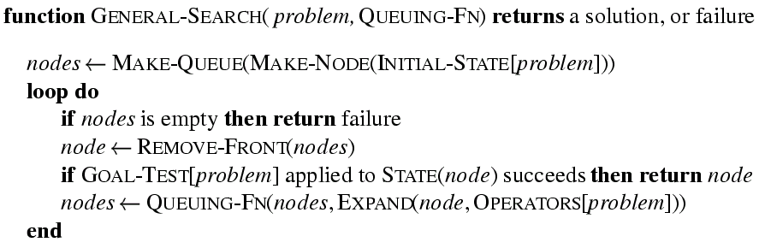
IS Core Units in CS2
A Taste of AI: Brute-Force Search
General Search (Russell and Norvig, 1995)

Slide 26
IS Core Units in CS2
A Taste of AI: Best-First Search
Small modifications to brute-force algorithms yield rich array of best-first search methods
Use priority queue as Queueing-Fn
Add heuristic function to search node

Slide 27
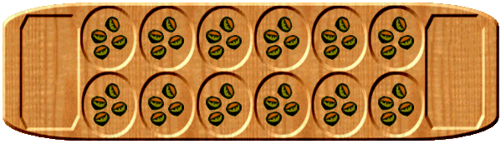
IS Core Units in CS2
Two-Player Games
Chief benefits:
Motivating example for object-oriented design
Exercise in recursive thinking
Design for real-time constraints
Example game: Mancala
Provide game-tree search node implementation with trivial heuristic function (e.g. score difference)
Students compete to design best heuristic evaluation fn

Slide 28
IS Core Units in CS2
Constraint satisfaction
n-queens problem
Chronological backtracking
  Depth-first search (DSP) in space of constraint-satisfying variable assignments
  E.g. assign position of queen 1, queen 2, …, queen n
  Two birds with one stone: DFS already implemented!

